Slide 1
Digital Portfolio
STUDENT NAME: Premkumar N
REGISTER NO AND NMID: astvu20324u09062
DEPARTMENT: Bca
COLLEGE: Dr.Mgr.Chokkalingam Arts College/ Thiruvalluvar UNIVERSITY

Slide 2
PROJECT TITLE
Student digital portfolio using front end development

Slide 3


AGENDA
Problem Statement
Project Overview
End Users
Tools and Technologies
Portfolio design and Layout
Features and Functionality
Results and Screenshots
Conclusion
Github Link
3/21/2024 Annual Review

Slide 4

PROBLEM STATEMENT
In today’s digital world, showcasing personal skills and achievements online is essential.
Many students and professionals struggle to present their work effectively.
The problem is the lack of a simple, professional, and user-friendly portfolio website to highlight personal information, skills, and projects in an attractive way.

Slide 5

PROJECT OVERVIEW
This project is a personal portfolio website created for Prem Kumar N.
It provides a digital space to introduce himself, showcase skills, and share work with potential recruiters, teachers, or collaborators.
The site includes a home section with a welcoming hero banner and an about section with profile details.
The design is clean, responsive, and user-friendly.

Slide 6

WHO ARE THE END USERS?
Students & Job Seekers – to showcase resumes, skills, and projects.
Recruiters & Employers – to quickly learn about the candidate’s profile.
Teachers & Mentors – to track student achievements.
General Visitors – to know about the individual’s work and interests.

Slide 7

TOOLS AND TECHNIQUES
Frontend: HTML5, CSS3, JavaScriptHTML5 is used to structure the web pages with semantic elements like <header>, <section>, and <footer>.CSS3 is applied to style the layout, add colors, gradients, and responsiveness. JavaScript provides interactivity (for example, smooth scrolling from the hero button to the About section).
2. Styling: Flexbox, CSS Gradients Flexbox makes the layout responsive and aligns elements properly across devices.CSS Gradients create modern background effects (linear gradient in the hero section).
3. Editor: Visual Studio Code (VS Code)A lightweight yet powerful code editor. Provides syntax highlighting, extensions for live server preview, and debugging support.
4. Version Control: Git & GitHubGit tracks project changes and helps manage versions of code. GitHub hosts the portfolio online and allows easy sharing of code with others.

Slide 8
POTFOLIO DESIGN AND LAYOUT
Navbar: Dark background with logo and navigation links.
Hero Section: Gradient background with a greeting, name highlight, and call-to-action button.
About Section: Profile photo with a short description.
Responsive Layout: Flexbox-based, mobile-friendly.
8

Slide 9
FEATURES AND FUNCTIONALITY
Smooth Navigation: Navbar with anchor links. Scroll-to-Section: JavaScript smooth scrolling to “About” section.
Profile Display: Circular profile image.
Modern UI: Gradient hero background, highlighted name text.
Call-to-Action Button: Directs user to work section.

Slide 10
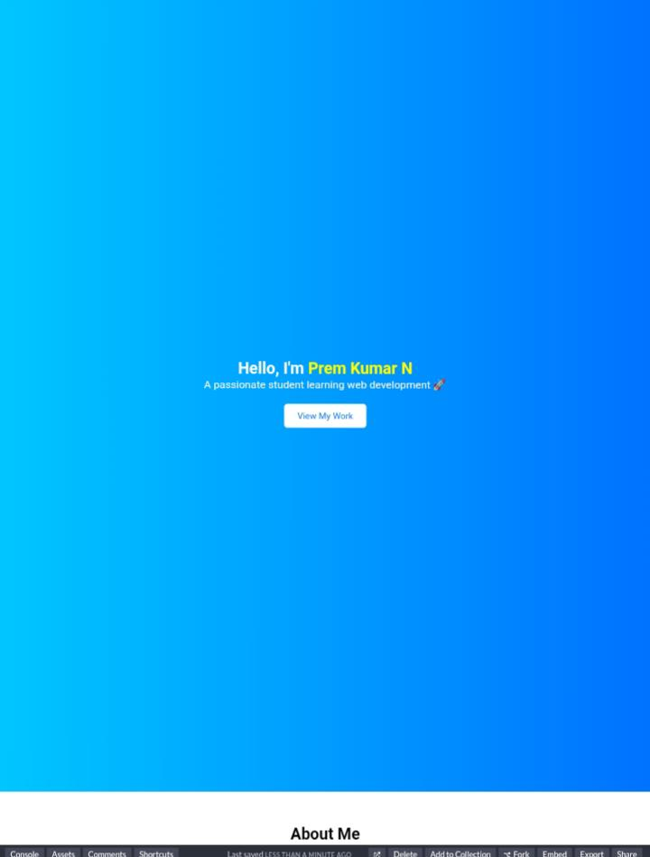

RESULTS AND SCREENSHOTS
3/21/2024 Annual Review
10

Slide 11
CONCLUSION
This portfolio website successfully solves the problem of presenting an individual’s identity and skills in an interactive and professional manner.
It is simple, responsive, and can be extended by adding sections like projects, contact form, or resume download.
11

